Slide 1







BASIC DATA
STRUCTURES
By: Soila Paiz

Slide 2
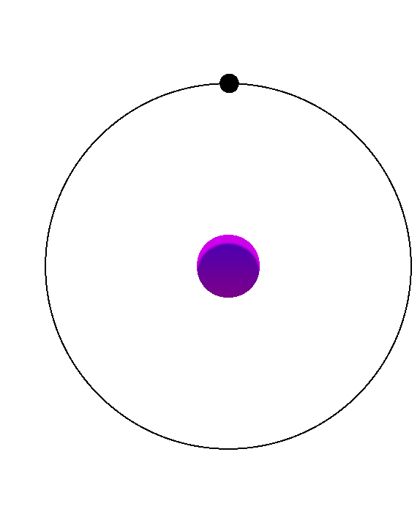
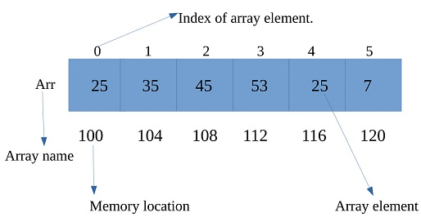
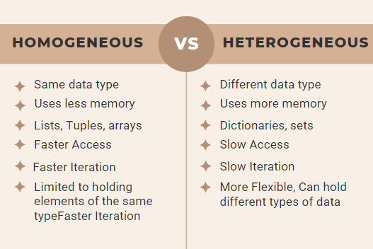
ARRAYS
An array is used to store multiple items of the same type (such as numbers, names, or letters) in one location.

Slide 3
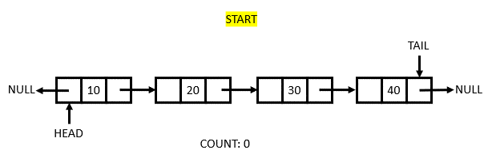
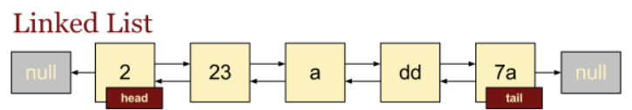
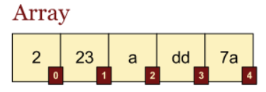
LIST
A list is a collection of items (like numbers, names, or words) that are kept in order. You can easily add, remove, or view the items.
Examples:

Slide 4

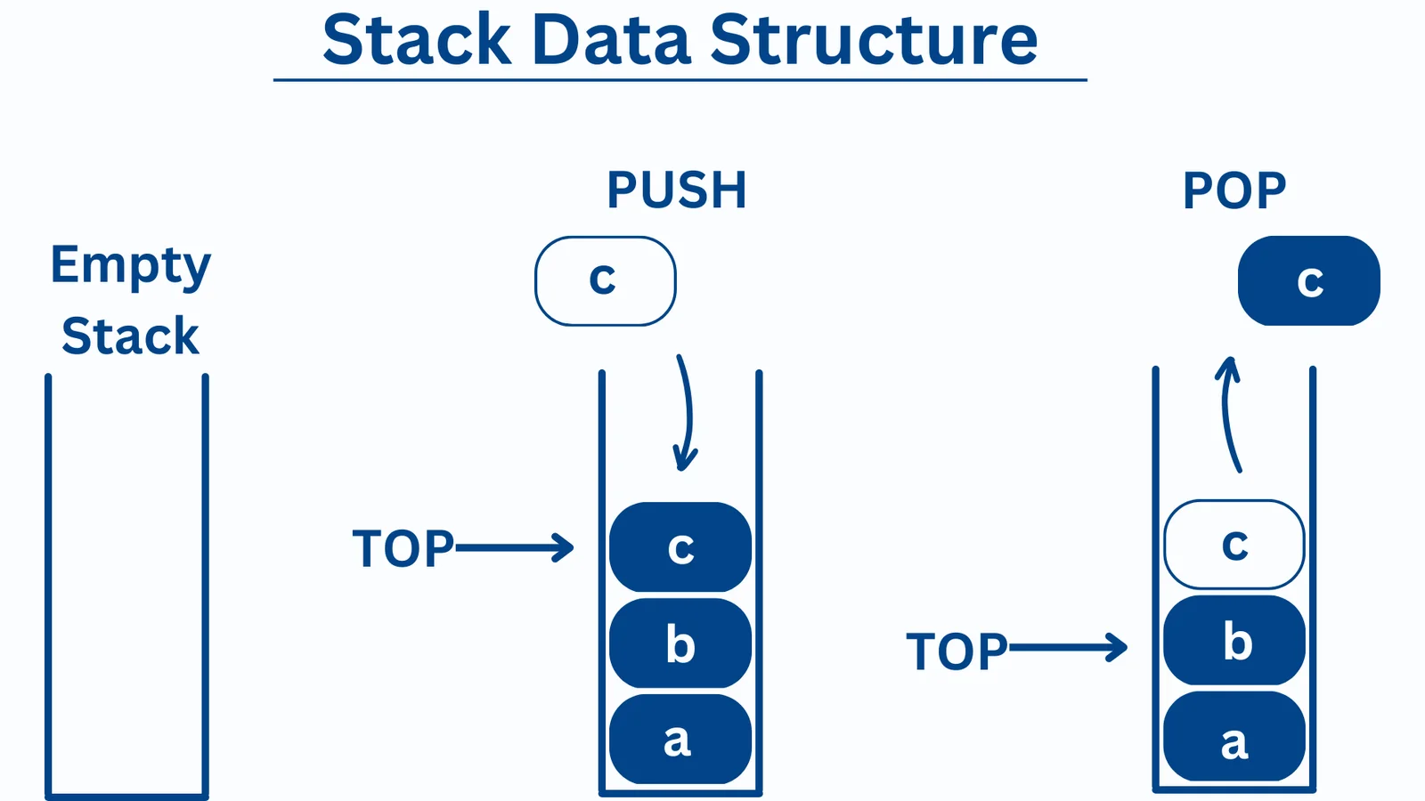
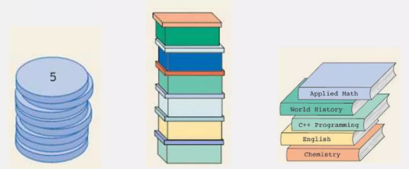
STACKS
A stack is a way to store and organize items where you can only add or remove items from the top.
Key Rule: LIFO — Last In, First Out

Slide 5
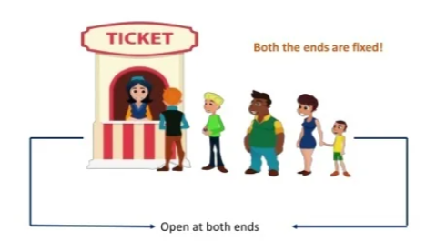
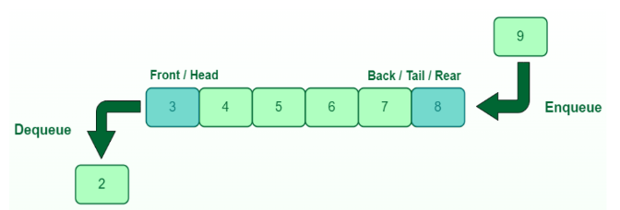
QUEUES
A queue is a linear data structure that follows the FIFO principle, where insertion is done at the rear end and deletion is done from the front end.

Slide 6
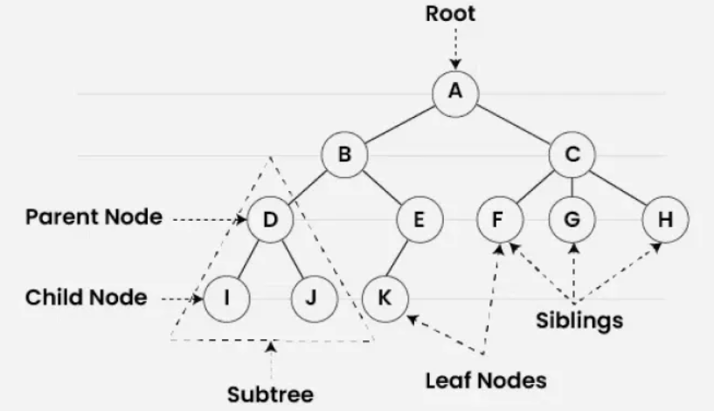
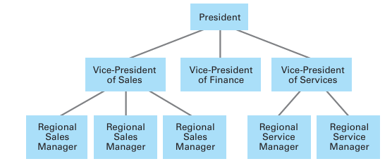
TREES
A tree is a hierarchical data structure used to organize and represent data in a parent–child relationship.

Slide 7
THANK YOU!

